Slide 1
Decision Trees
Fred Martin, Irene Lee, Ruizhe Ma

Slide 2
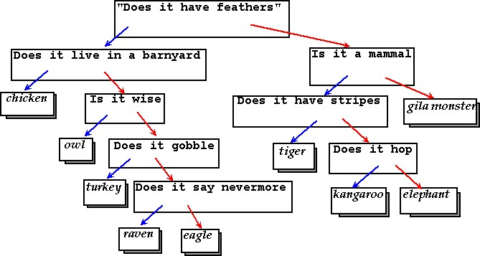
The 20 Questions Game
From https://courses.cs.duke.edu/compsci201/fall13/wordpress/index.html%3Fp=383.html

Slide 3
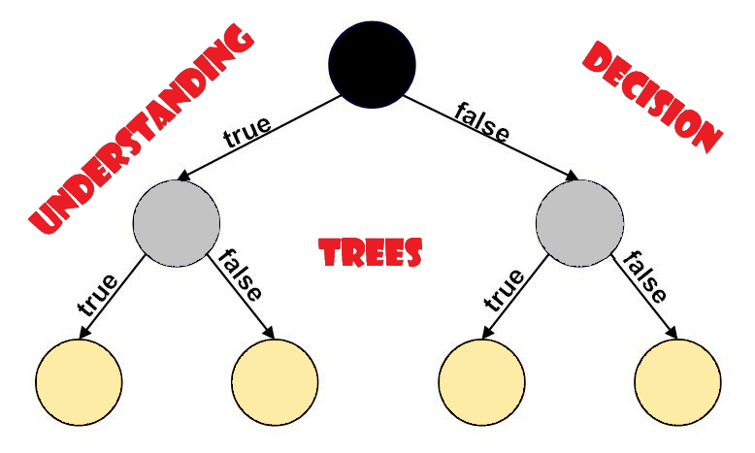
from https://medium.com/analytics-vidhya/understanding-decision-tree-3591922690a6

Slide 4
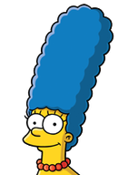

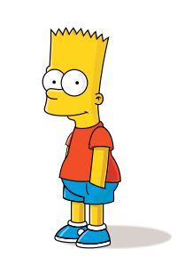

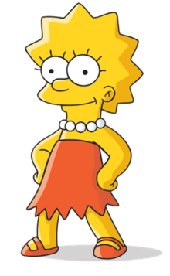

Long hair?
Necklace?
Male?
Decision Tree #1 for the Simpsons
Glasses?
R. Ma
Notes:
4

Slide 5
Glasses?
Necklace?
Male?
Necklace?
Decision Tree #2 for the Simpsons
R. Ma

Slide 6
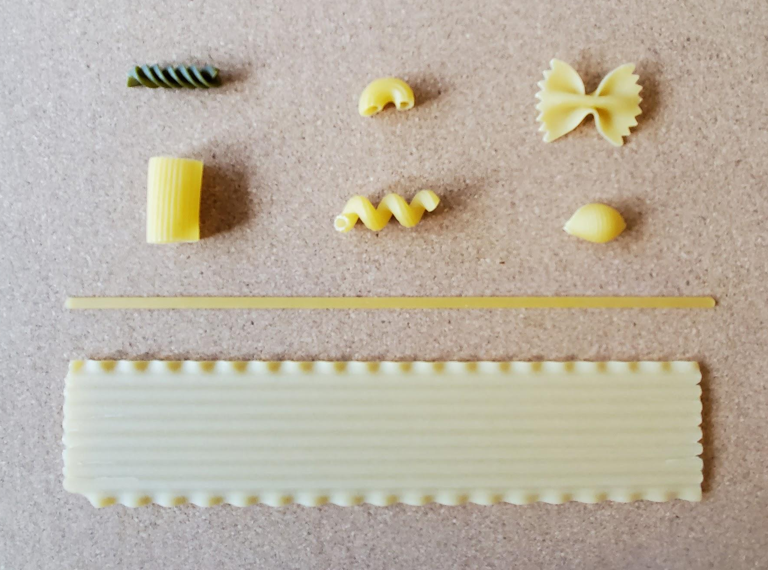
Rotini
Farfalle
Elbow
Your kit
Rigatoni
Cavatappi
Shell
Your task:
Make a decision tree to classify each type
Linguini
Lasagne

Slide 7
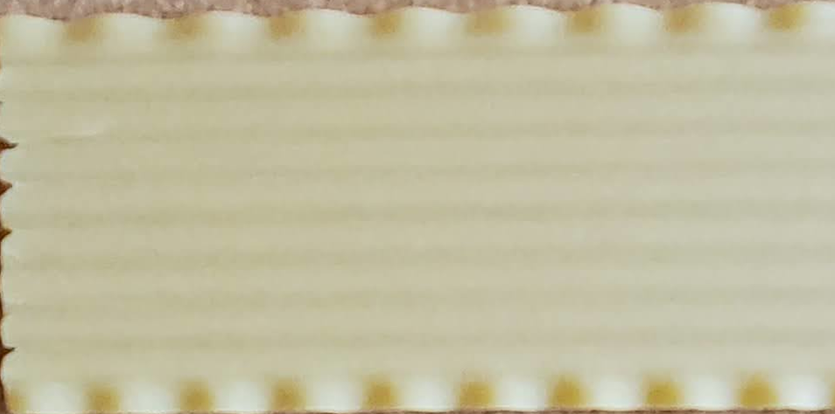
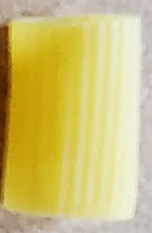
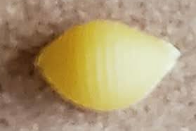
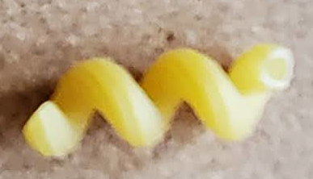
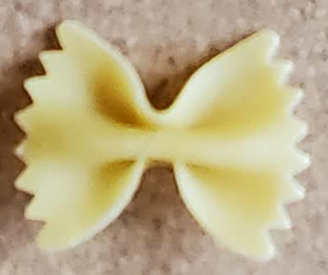
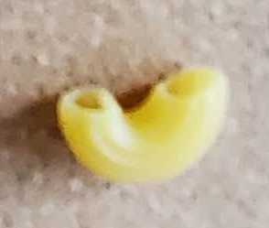
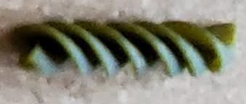
Is it flat?
yes
no

Slide 8
Is it hollow?
yes
no

Slide 9
Your turn!
yes
no
yes
no
yes
no

Slide 10
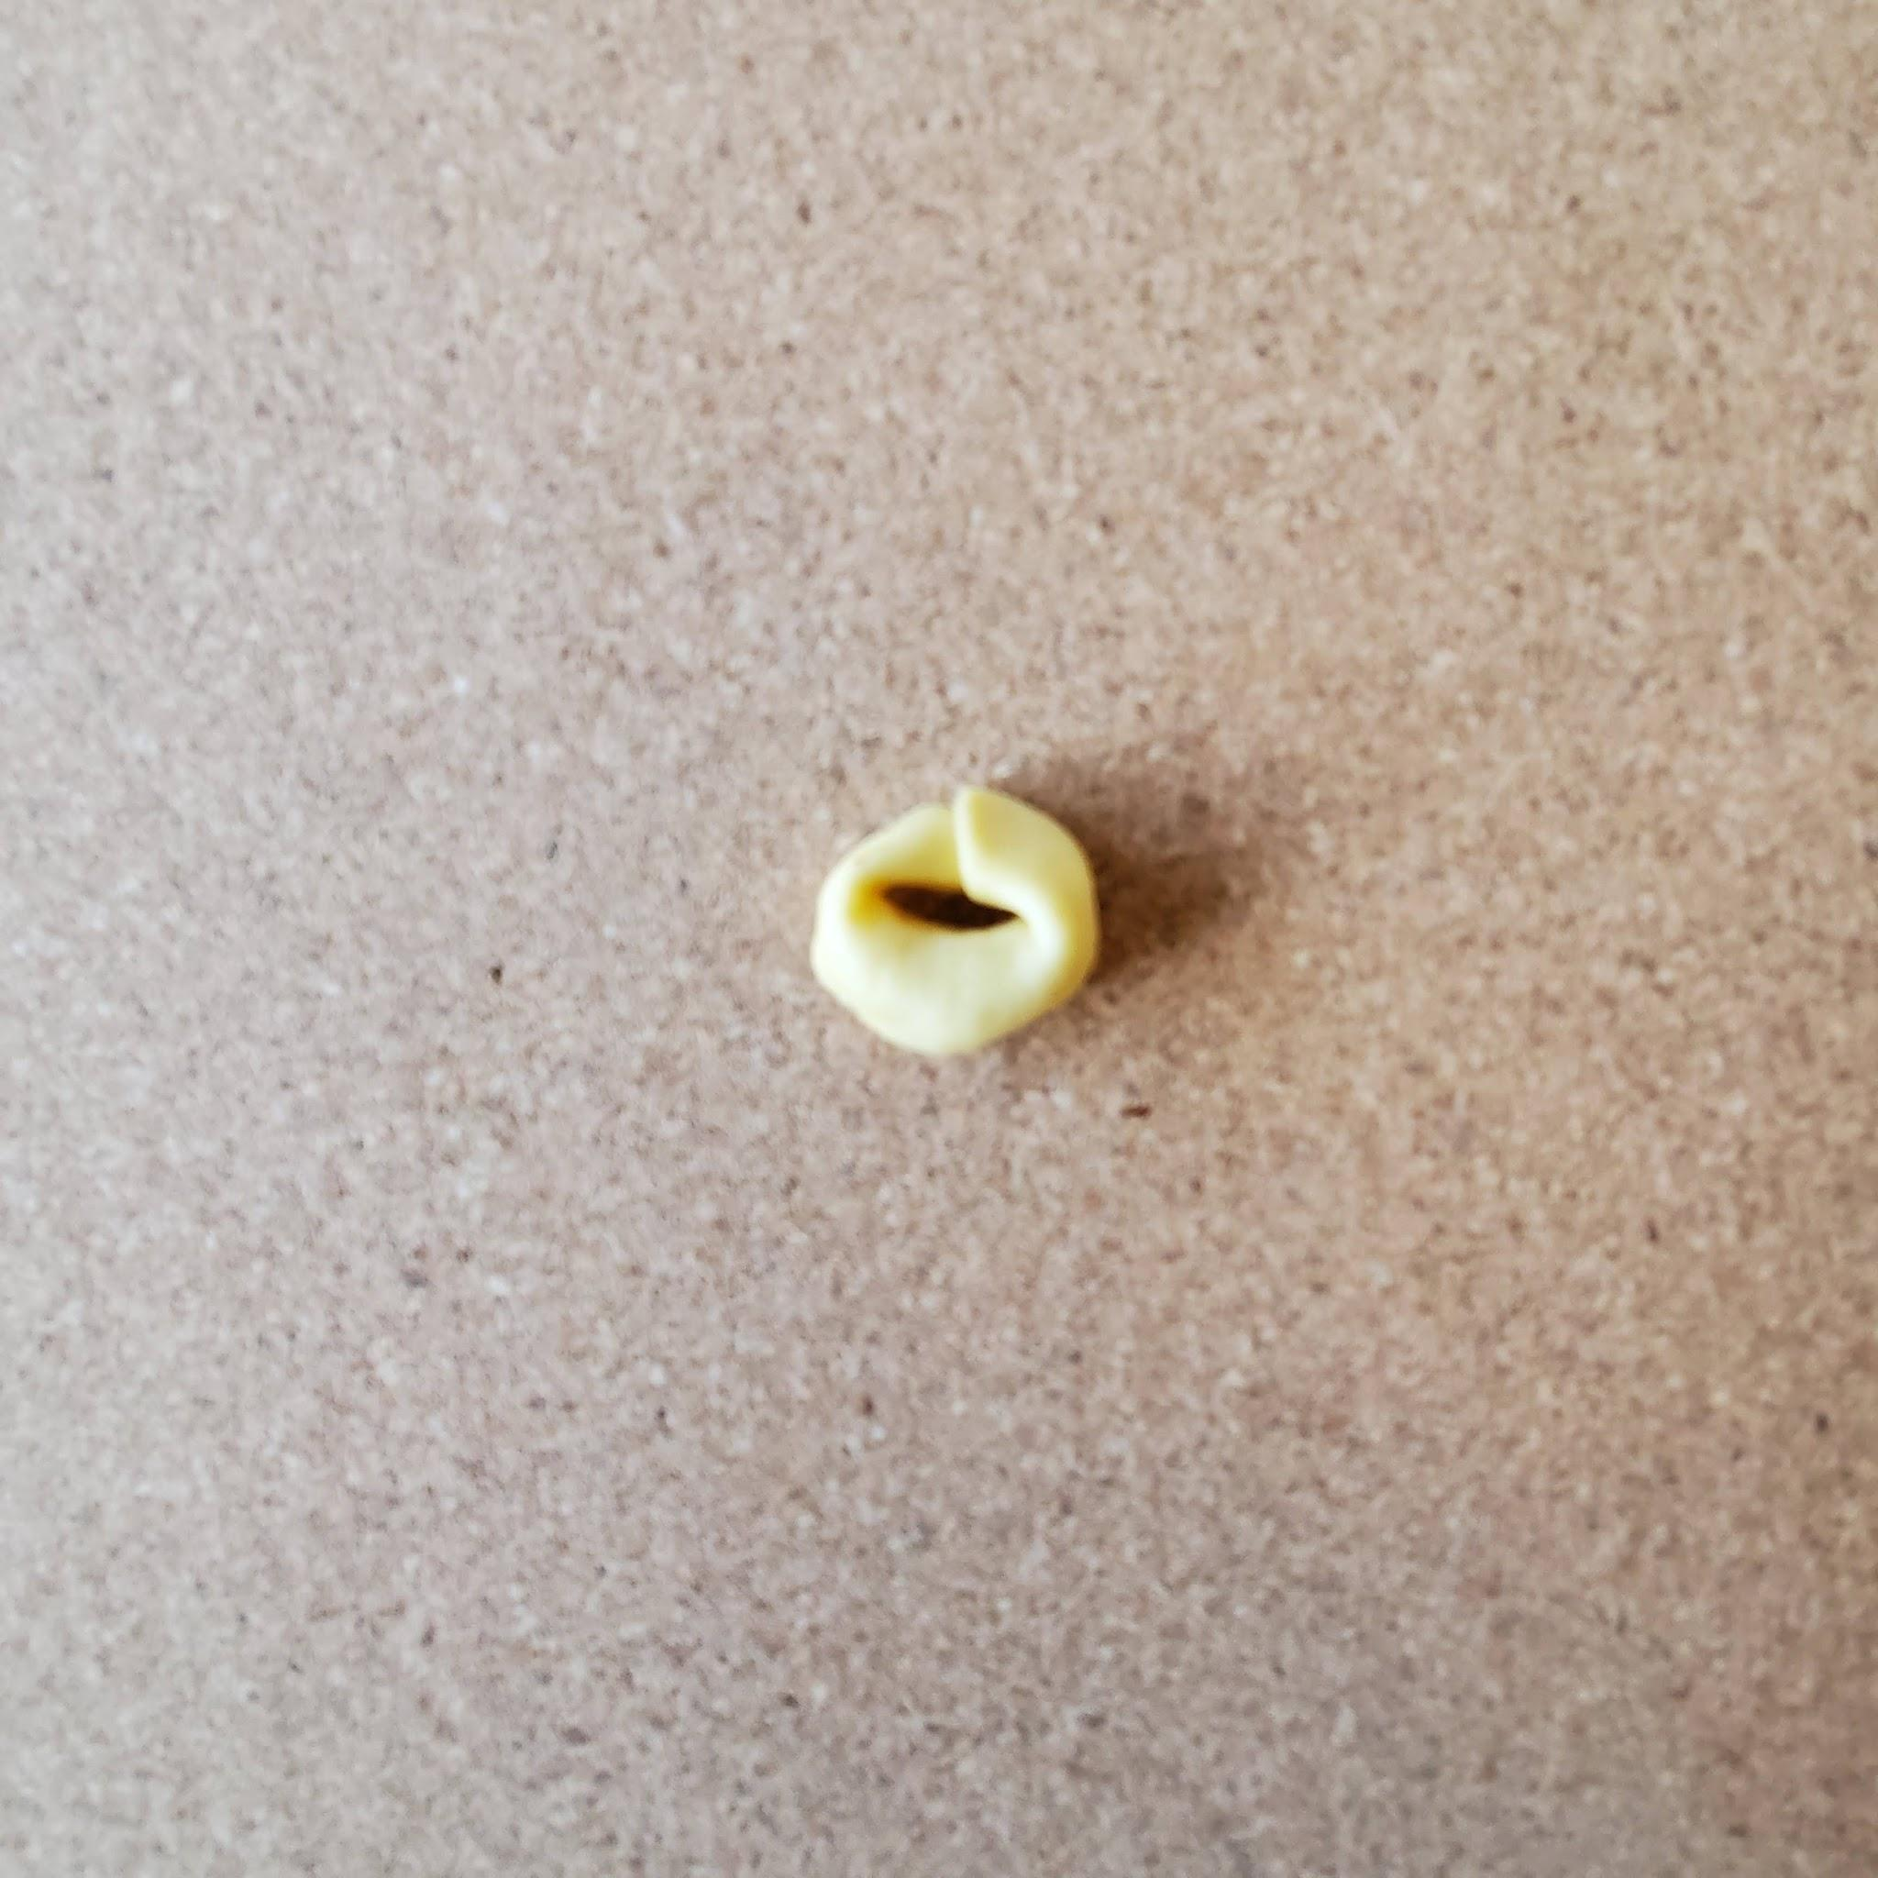
THE MYSTERY PASTA!
Cheese Tortellini

Slide 11
What happened with the mystery pasta?
Did your tree classify it with a closely related pasta shape?
Does your tree capture what’s important about it?
If not... your tree might have bias

